Slide 1

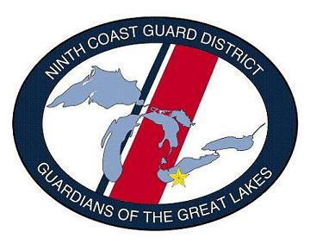
SABOT
  Standardized Auxiliary Boat Operations Training
  Ninth District - Eastern Region
  COMO. Lew Wargo, Sr.
  CQEC-9ER
  01 APR 2015
  UNIFORMS

Slide 2
SABOT
AUXILIARY
PPE GEAR

Slide 3
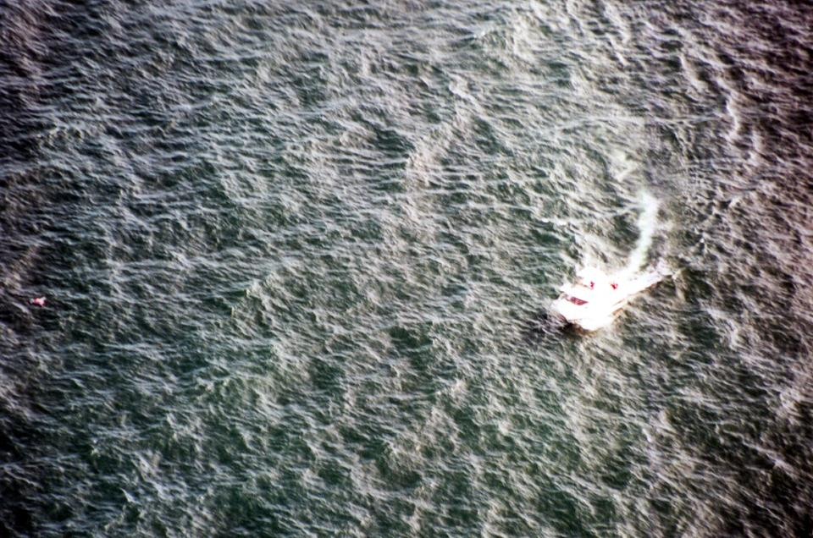
PPE for Survival

Slide 4
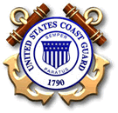
The Right Gear at the Right Time
(PPE)

Slide 5
Reference’s
Rescue and Survival System’s Manual, COMDTINST M10470.10G
Boat Crew Seamanship Manual,
COMDTINST M16114.5B
Non-Standard Operator’s Handbook,
COMDTINST M16114.28

Slide 6
Objectives
The importance of PPE to your survival.
Identify PPE Gear and Levels.
Identify requirements for the wearing of PPE.
How to properly don PPE.
Requirements for individual PPE inspection.
Identify who has the authority to grant waivers on PPE and the stipulations.
Requirements for documentation of PPE issue.

Slide 7
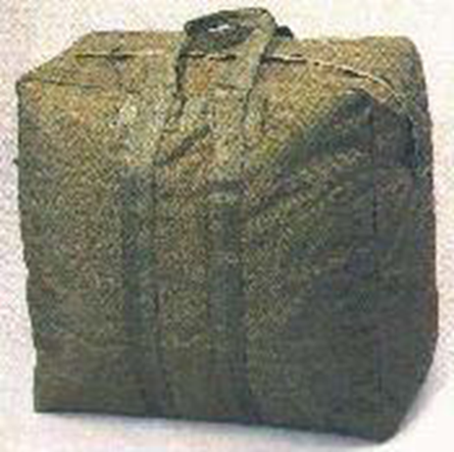
-Once a member becomes qualified, the QE will forward the members sizes to the OTO office. Once the members information is received, a complete SAR Bag of PPE will be issued.

Slide 8

“STANDARD ISSUED
GEAR”
IN
SAR BAG

Slide 9
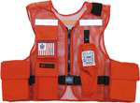
-A lightweight yet ruggedly built nylon mesh vest designed to provide stowage for survival equipment items.
-Contains 5 pockets constructed of a heavy duty 1050 denier ballistics nylon. The 2 main pockets are located on each side of the vest for best weight distribution (a portion of the load is transferred to the shoulders) of heavy/bulky items, such as flares, signal mirrors, dye markers, etc.
-The front of the vest has a knife pocket, a strobe light pocket and a utility pocket.
-The adjustors, zippers and snaps are all high strength plastic for corrosion resistance. Vest can be adjusted to fit in a few seconds by simply pulling forward on the adjustment straps. Retro reflective material is sewn to the front and back of the vest for high visibility both day and night.
-The back of vest has Coast Guard Auxiliary in white letters.
-The left shoulder has sewn in Velcro for the attachment of the strobe light or PLB.
Survival Vest

Slide 10
SAR Vest Outfit
This is not required. Optional for those that switch between PFD, float coat, or Work suit (Hypothermia coveralls).
The Survival Vest IS NOT A FLOTATION DEVICE and MUST be worn over your personal flotation device!!
Each item should be in the described location in every vest.
Each item is standardized and outfitted according to the Rescue and Survival Manual
Each item is required to be tethered to the vests pocket with a nylon cord lanyard.
Not to be worn with an inflatable PFD.

Slide 11

This 4.25" x 2.75" acrylic mirror is virtually unbreakable and weighs 1.8 ounces.
Designed to provide optimum sighting "spot" with holographic red dot and features telescope quality reflective surface.
Operates on the same principle as the glass military signal mirrors with grid/fireball targeting. Mirror includes USCG approved whistle.
Operating instructions are also printed on back of Mirror.
#208-HS ACR Hot Shot
TM Signal Mirror

Slide 12
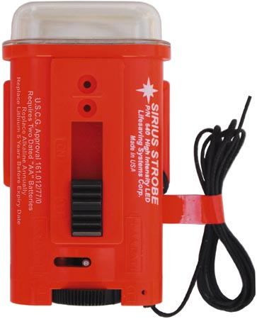
#640 Sirius LED Strobe Light
• Dimensions: 4.6 x 2.0 x 1.1 inches (L x W x H)
• Weight: 3.3 ounces (typical with batteries).
• Visible from 2-5 miles, subject to atmospheric conditions.
• Strobe flash rate of 60 +/- 5 flashes per minute.
• Operational/Battery life: Minimum 8 hours continuous per USCG approval requirements. Typical 20+ hours.
•Battery Type: Two dated AA alkaline or lithium batteries (batteries not included). Lithium recommended for cold environments.

Slide 13

The basic survival tool. A high quality, compact, lightweight, snag and corrosion resistant knife manufactured by LSC. This knife has a razor sharp, 4" mirror finish stainless steel blade with blunt tip. The upper edge of the blade is serrated and features a line cutter.
Handle is constructed of sure-grip ABS plastic with a lanyard hole. Includes rubber belt sheath with integrated safety retainer.
Do Not sharpen tip of knife!
Not required. Folding knife may be used.
#4220 01 27803007
Survival Knife

Slide 14

The Personnel Marker Light (PML) is a safe chemical light approved by the USCG and the
FAA for use on life preservers. Squeeze handle to activate. When activated, the PML emits a yellow-green glow which lasts for a minimum 8 hours & is visible up to 1 mile on clear, dark nights.
A superb emergency light source for life preservers as it is waterproof, windproof, nonflammable, easy to activate, and requires no batteries.
Four year shelf life.
Optional item.
#231 Cyalume®
PML Chemical Light

Slide 15
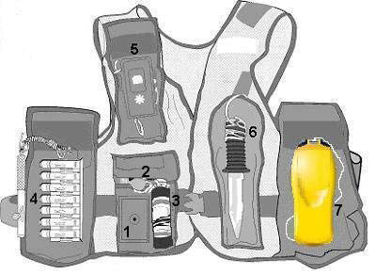
SAR Vest Equipment and Location
Each item must be in the correct pocket as shown below
Emergency Signaling Mirror
Signal Whistle
Marine Smoke and Illumination Signal (Not Aux)
Illumination Signal Kit (Not Aux)
Distress Signal Light
Survival Knife
Personal Locator Beacon (PLB)

Slide 16
Most Asked question & Misunderstanding!
Question: Are the sar vest lanyards supposed to be 36” before or after the item is attached?
-Answer: (Directly from the SAR VEST Maintenance Procedure Card)
One sear cut 42-inch length of Type I nylon cord, should be used.
Attach the 42-inch nylon cord to the item and the other end to the tab located in the designated pocket using a bowline followed by an overhand knot.
NOTE: Finished length of line from knot to knot shall be 36-inches or greater.
ANY inspections, corrections or PPE changes should ONLY be completed by the designated AUX R&S officer.

Slide 17
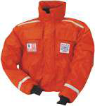
#344-A Powerboat Jacket w/CG Auxiliary Markings (Float Coat)
The original bomber style flotation jacket with extra comfort and mobility. Cut waistlength for freedom of movement. Soft Suisse Aire™ foam with a coated nylon shell.
Multiple pockets with full hook and loop closures.
USCG Approved Type III. SOLAS-grade reflective tape. Waterproof construction and design. Rib knit waist band and wrist bands. Four pockets, sleeve utility pocket, & inside chest pocket.
Sizes: XS–XXX.

Slide 18
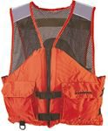
#460-A Utility Vest w/ CG Auxiliary Markings
New comfort series utility vest is specially designed with a soft, lightweight mesh on the upper half of the vest for comfort and ventilation.
USCG Approved Type III. Tough, nylon oxford outer shell material. Two 1" encircling body straps with zipper front for secure fit. Two pockets with hook and loop closure.
Light, durable Crosstech® flotation foam. D-rings for attaching gear. SOLAS-grade reflective tape.
Sizes: S–XXX

Slide 19

#327-A Challenger™ Work Suit w/ CG Auxiliary Markings
Features sealed seams for 100% integrity and allows full range of motion. All day comfort in the world's most demanding sea environments.
• USCG Approved Type III/V (Anti-Exposure Coverall).
• Adjustment Straps on ankles, thighs, and wrists.
• Insulated hood to keep wind and rain out.
• Inflatable head support.
• Adjustable waist belt.
• Leg zippers for easy on/off over work boots.
• Neoprene wrist closures for a comfortable, watertight fit.
• Generous pockets plus hand warmer pockets.
• Double layer of durable nylon fabric in seat and knees.
• 62 sq. in. of SOLAS grade reflective tape.
Sizes: XS–XXX

Slide 20

Regardless of weather and other equipment, Personal Flotation Devices and a Boat Crew Survival Vest with properly maintained and functional equipment shall always be worn underway.

Slide 21
PPE TEMPERATURE REQUIREMENTS

Slide 22
INSPECTIONS
When do we inspect PPE gear?
Semi-Annually, and before
and after every use.

Slide 23
INSPECTIONS
Why do we inspect PPE gear?
For your safety and the safety of your crew and passenger’s.

Slide 24
INSPECTIONS
What are we looking for?
Rips, tears, zipper lock, rust, missing gear or broken clips, faded letters etc…

Slide 25
INSPECTIONS
Who is responsible for inspecting PPE?
-R&S Officer for semi-annual inspections, -Each individual whom is issued PPE, prior to and after each mission.
The R&S Officer ensures that all PPE inspections are conducted on time and all deficiencies are noted and/or corrected. All PPE inspections must be logged on inspection forms and the OTO office must be notified of all results.

Slide 26
PPE WAIVER
What is a PPE waiver?
A determination that the risk associated with the crew performance degradation, thermal stress, and environment considerations are offset by the gain associated by the waiver.

Slide 27
PPE Waiver
Who can grant a PPE waiver?
The CO/OIC (OIA), on a mission by mission basis only, may waive the requirement for wearing hypothermia protection devices.
If a waiver is authorized, the waived gear must be taken underway.

Slide 28
Survival Times/Waiver Considerations
14
Dry Suit
12
10
Estimated time (Hours) to loss of useful Consciousness
Anti-exposure Coveralls
8
6
4
Work Uniform
2
0
32
41
50
59
68
Water Temp. – Degrees F

Slide 29
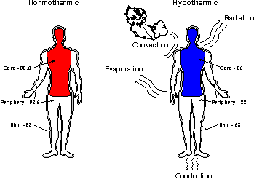
Hypothermia

Slide 30
Hypothermia
98.6 to 96.0 degrees is Mild Hypothermia
95.0 to 93.0 degrees is Moderate Hypothermia
92.0 to 86.0 degrees is Severe Hypothermia
90.0 degrees or below, without intervention, DEATH is eminent.

Slide 31
Hypothermia
Water conducts heat away from the body, at a rate, 20 times faster than air. This includes water from sweating or intrusion of a dry suit or MSD 900.

Slide 32
Signs of Early
Hypothermia
“Umbles”
Mumbles
Grumbles
Fumbles
Stumbles

Slide 33
Personal Locating Beacon
(PLB)
(Required on all underway crew & coxswains)

Slide 34
Reference’s
McMurdo Fastfind Owners Manual
www.mcmurdo.co.uk
Rescue and Survival System’s Manual, COMDTINST M10470.10G

Slide 35
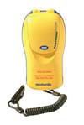
The Fastfind range of Personal Location Beacons has all the benefits of the 406MHz EPIRB except that they are registered to an individual as opposed to a vessel.
They operate on the 406Mhz global satellite rescue system ensuring that your emergency signal can be sent from anywhere in the world.
They also transmit a 121.5MHz homing signal and the Fastfind Plus version benefits from a dedicated built in GPS sending a highly accurate location position typically +/- 50metres within a few minutes of switching the unit on.
This enables the rescue authorities to greatly reduce their search time. There is also a -40°C battery option for colder climates. The Fastfind is of particular benefit if you are moving from boat to boat or having to work on deck in adverse weather conditions.
It is compact and should be tethered ensuring that you can safely move around without fear of losing the unit.
PLB replacement batteries available upon request.
Personal Locating
Beacon (PLB)

Slide 36
PLB
Command approval required to test
Manually activated
24 hour transmission life

Slide 37
PLB Registration
ALL PLB’s must be registered and copy of completed registration sent to OTO office if not already registered by the OTO office.
Can be registered online or by Fax, Mail or E-mail.
OIA: Listed as Primary Emergency Contact
Sector: Listed as Alternate Emergency Contact

Slide 38
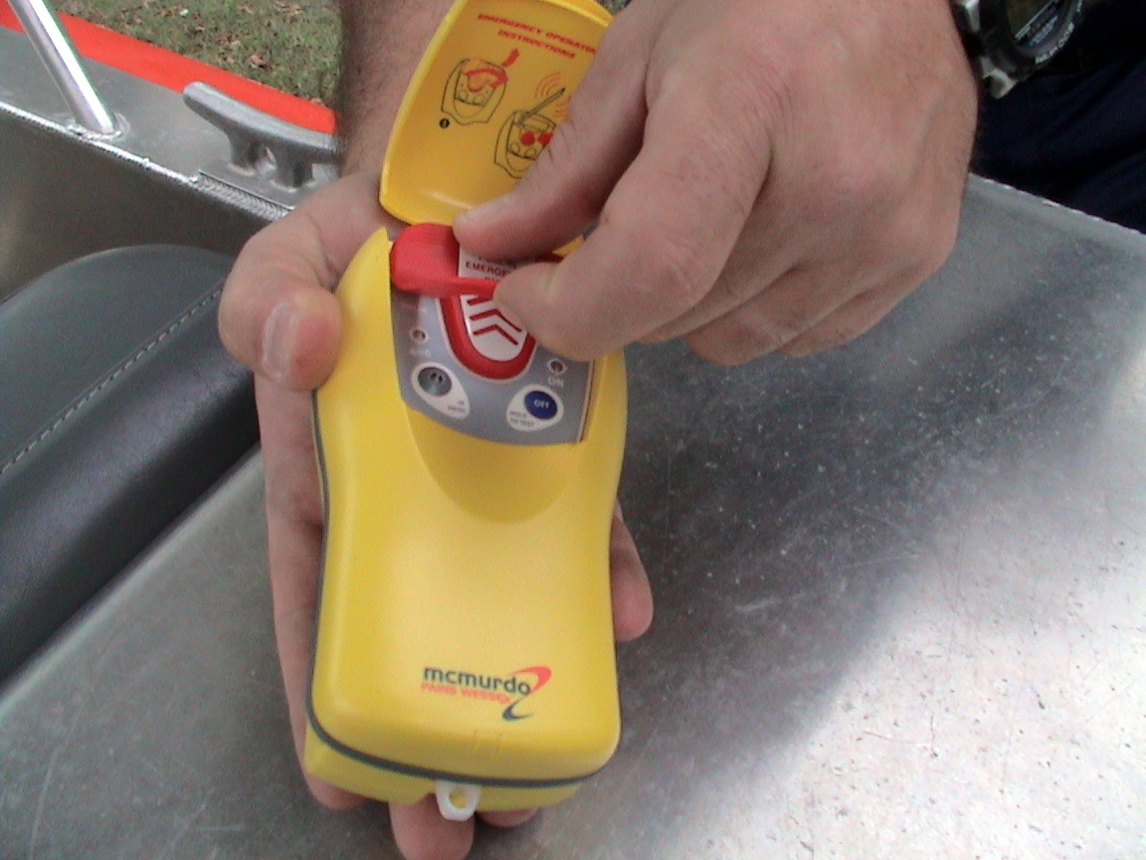
PLB – Self test

Slide 39
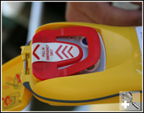
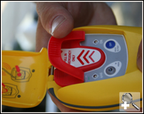
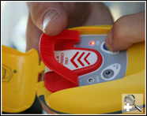
PLB self test as follows:
A. Open the flip-top lid. Do NOT pull off the red anti-tamper cover.
B. Self-test uses the OFF/Test button, located under the flexible handle of the red anti-tamper cover on the right side
C. Slide a finger under the flexible handle of the anti-tamper cover to operate the OFF/Test button. Press the switch and HOLD IT DOWN until the self-test sequence is completed. This will take 8 seconds. While the button is held down and self-test sequence is in progress, the red indicator light marked "ON" (above the switch) will illuminate.
NOTE: REPETITIVE TESTING WILL DIMINISH THE BATTERY LIFE.

Slide 40
PLB Self Test cont.
D. On successful completion of the self-test sequence, the green light on the left will flash 3 times and the buzzer will sound 3 times. The PLB will switch itself off after completing the self-test, even if the off button is still held down.
E. Release the button and close the flip-top lid.
F. If self-test fails, repeat test procedures. If the problem persists, check the battery expiration date. DO NOT use the PLB, immediately notify Division R&S Officer. Division R&S officer will collect PLB to verify problem and notify OTO office Immediately for replacement.

Slide 41
PLB Do’s and Don’t’s
DO NOT…..
Do not tamper with red cover
Do not place near large metal objects
Do not submerge/cover antenna
Do not test more than once a month
DO….
Do notify OIA before conducting self test

Slide 42
NOW how important is PPE?

Slide 43
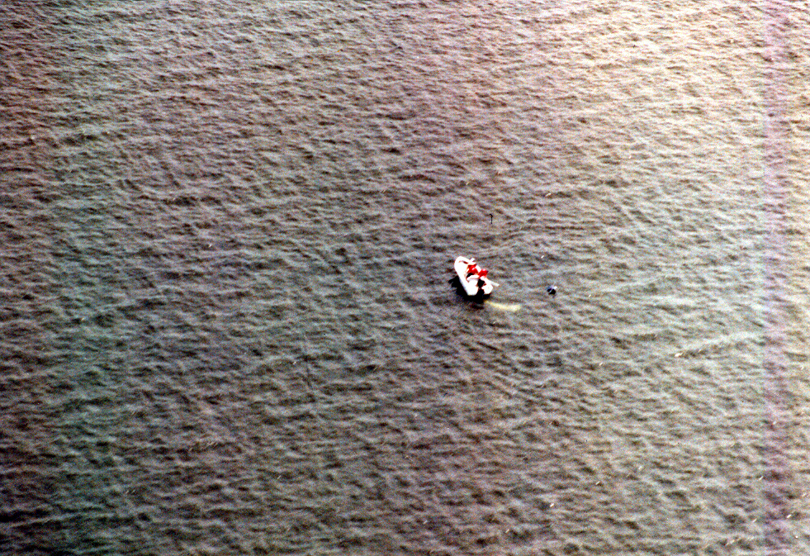
Is this person easy to see?

Slide 44
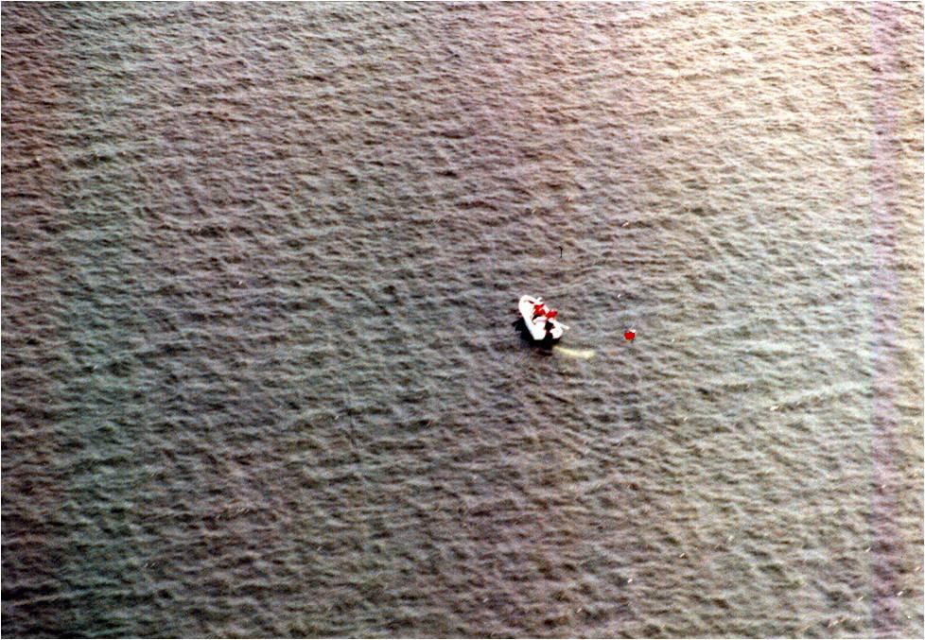
Or is this person?

